Slide 1

Hospitalization Stays Prediction
Tom Hines & Karthik Radhakrishnan

Slide 2
Project Objectives
Objective 1
Produce a regression model to verify whether infection risk and associated factors have an impact on a patient’s length of stay even after accounting for other variables.
Objective 2
Fit additional models to predict length of hospital stay and provide recommendation on which model would be the best to predict future patient’s hospital stays.
(At least one MLR with added complexity and another non-Parametric model)

Slide 3
Data Description
Data set consists of 11 variables collected on each of 113 hospitals.
Breakdown:
8 Numerical explanatory variables
2 Categorical explanatory variables
1 Response variable
No Missing or Duplicated Values
Variable Name | Description
Hospital ID | ID of the hospital
Length of Stay | Average length of stay (in days)
Age | Average age of patients (years)
Infection risk | Average estimated probability of hospital infection
Routine culturing ratio | Ratio of # of cultures performed to number of patients without symptoms of infection times 100
Routine chest X-ray ratio | Ratio of # of cultures performed to number of patients without symptoms of pneumonia time 100
Number of beds | Average number of beds
Medical School Affiliation | 1=Yes, 2=No
Region | Geographic region: 1=NE, 2=NC,3=S, 4=W
Average Daily census | Average number of patients in hospital per day
Number of nurses | Average number of full time nurses
Available facilities | Percent of 35 potential facilities and services that are provided by the hospital

Slide 4
Exploratory Data Analysis

Slide 5
Questions of Interest
What is the nature of the relationship between explanatory variables and response?
1
Does any multicollinearity exist between the explanatory variables?
2
Correlation Analysis between explanatory variables and response variable.
3
What is the impact, if any, of categorical variables on length of stay?
4

Slide 6
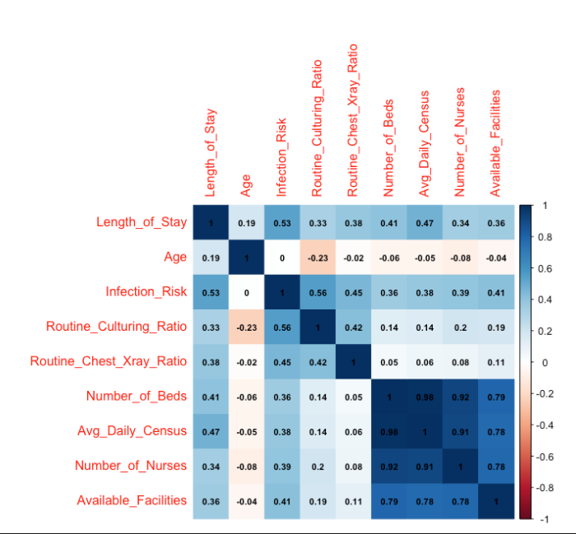
Correlation Analysis
Infection risk has moderate positive correlation with Length of Stay.
Number of beds and Number of nurses have high correlation with each other.
Number of beds and Average daily census have moderate positive correlation with Length of stay.

Slide 7
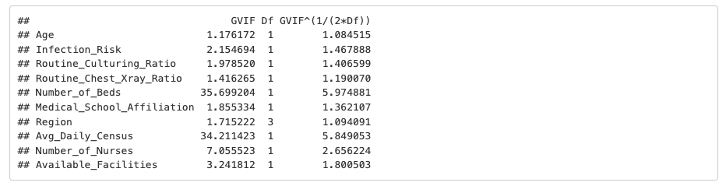
Multicollinearity
VIF is calculated from the simple multi linear regression model with all the predictor variables without any complexity.
Number_of_Beds (5.97) and Avg_Daily_Census (5.85) have the highest VIF values, suggesting potential
multicollinearity issues with these variables.

Slide 8
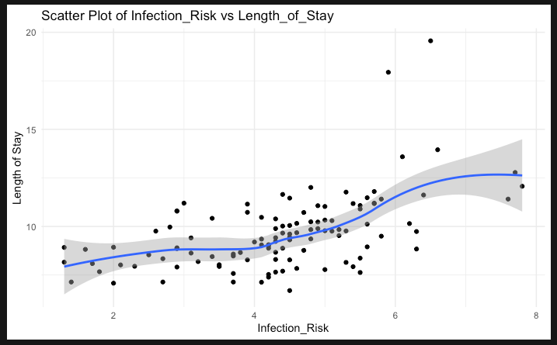
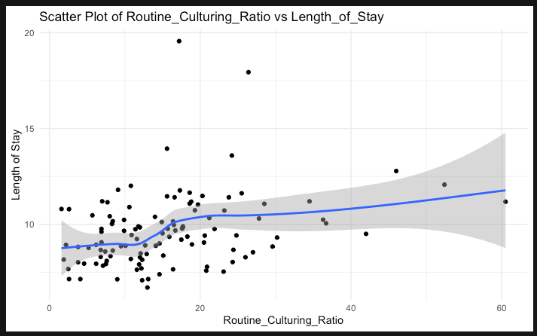
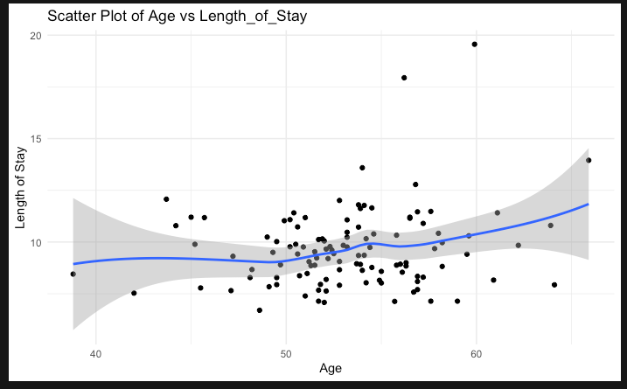
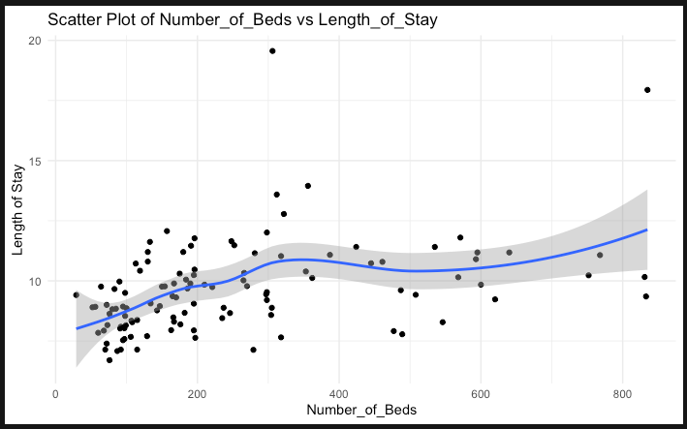
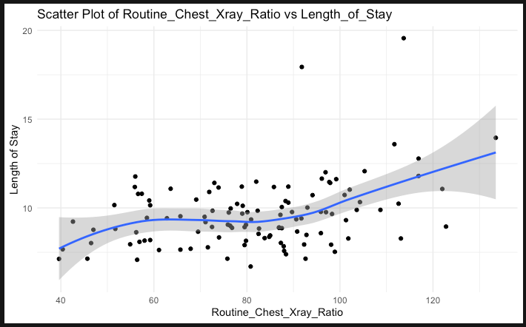
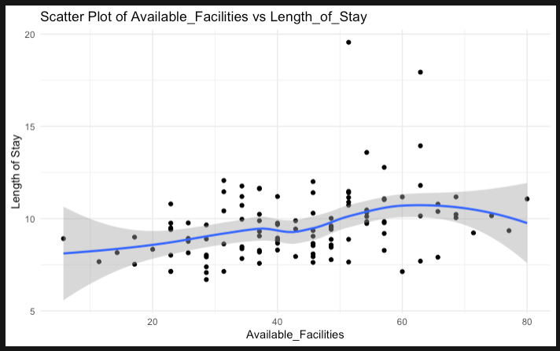
Relationship between numerical explanatory variables and response variable
None of the numerical explanatory variables have clear linear relationship with length of stay.
Infection Risk, Number of Beds and Routine Chest X ray variables have moderate linear positive trend with length of stay.
Age, Routine Culturing Ration and Available facilities have weak or unclear linear relationships with length of stay

Slide 9
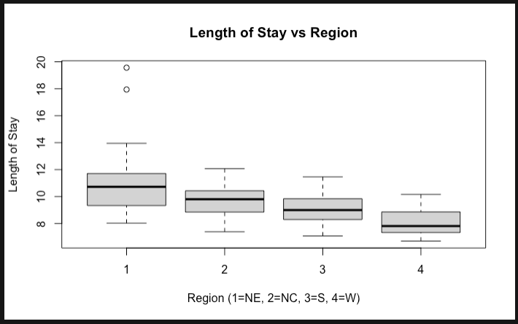
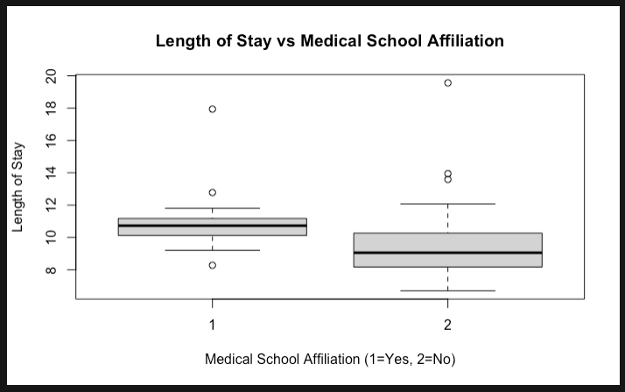
Impact of Categorical Variables
The Northeast region has longer hospital stays, whereas the West has shorter and less variable stays.
Medical school-affiliated hospitals have slightly longer, and more variable hospital stays, possibly due to differences in care practices often found in teaching hospitals.

Slide 10
Objective 1

Slide 11
Approach
Feature
Selection
Feature Selection using Lasso regression after Scaling.
Model Building
Build a MLR model with features selected by Lasso regression.
Assumption Validations
Check whether assumptions of MLR is met by the model.
Apply
transformations (if needed)
Apply transformations if assumptions are not met.
Answer
Answer the primary question in Objective 1 with interpretation of regression coefficient along with confidence interval.

Slide 12
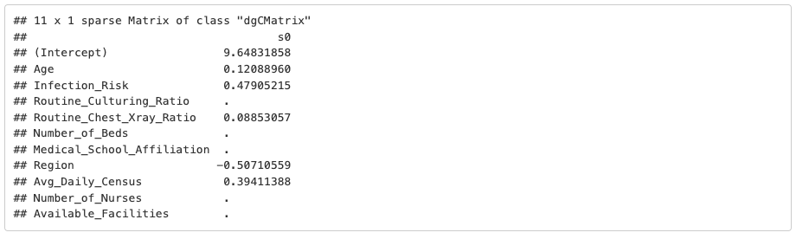
Feature Selection by Lasso Regression
Lasso regression is used for feature selection after scaling the variables.
Below are the variables selected.
Notes:
1. Steps – First simple random forest model, Addressed class imbalance, did hyper parameter tuning

Slide 13
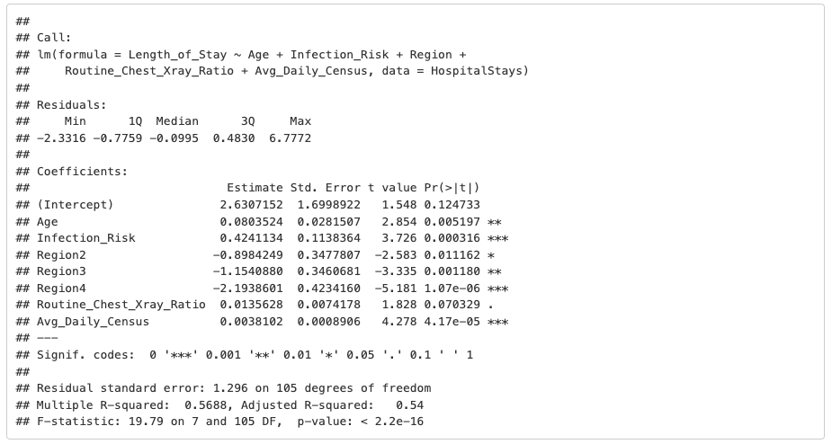
MLR Model
MLR model built using the features selected by Lasso.
Length_of_Stay ~ Age + Infection_Risk + Region + Routine_Chest_Xray_Ratio+ Avg_Daily_Census

Slide 14
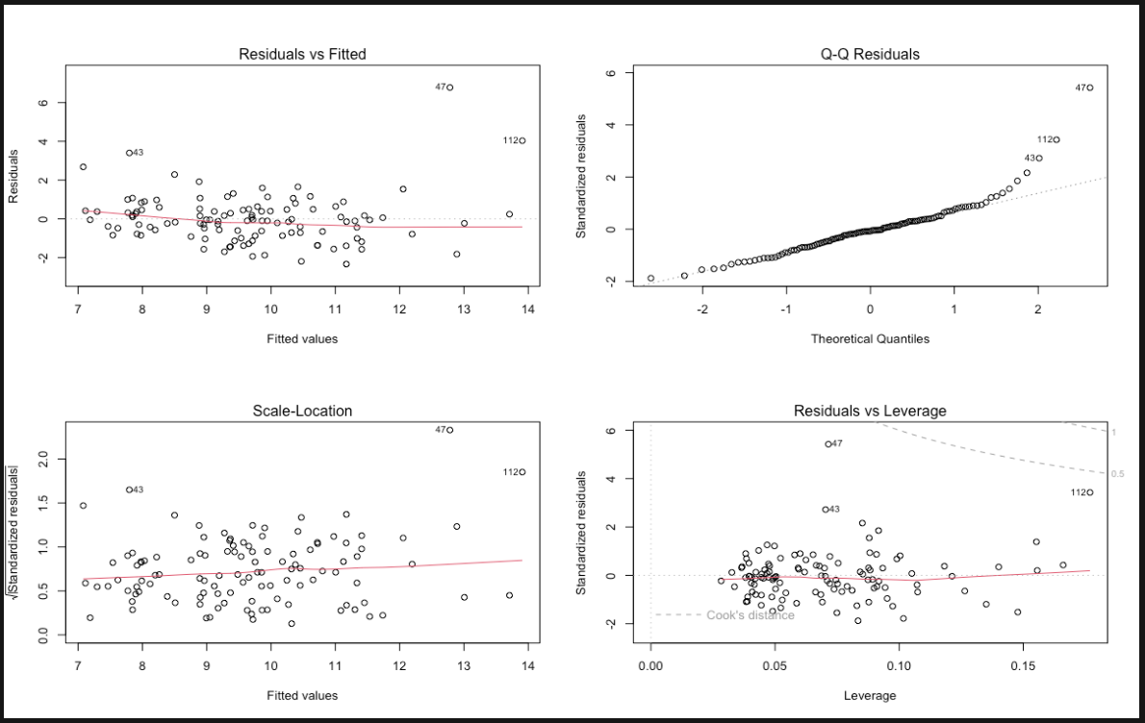
Assumptions Validation
Residual plots
Linearity: Generally satisfied, as there's no clear non-linear pattern in the residuals vs fitted plot.
Constant Variance: Mild violation, as the spread of residuals increases slightly with fitted values in the Scale-Location plot
Normality: As per the Q-Q plot, residuals are approximately normally distributed, with some potential outliers in the upper tail.
Independence: We assume independence of observations since there is no indication from data description to suggest this is violated.
Influential outliers: No outliers outside of cook’s distance lines.

Slide 15
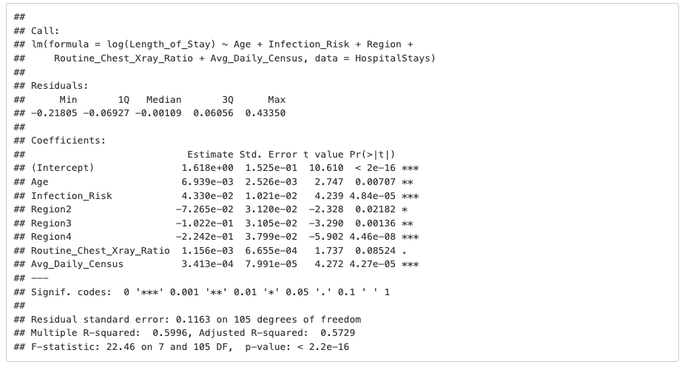
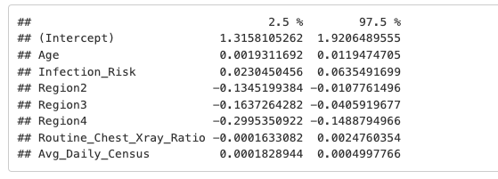
Applying Transformations
Applying log transformation of response variable since constant variance assumption is not met and building another model.
log(Length_of_Stay) ~ Age + Infection_Risk + Region + Routine_Chest_Xray_Ratio+ Avg_Daily_Census
Regression coefficients
Confidence Intervals

Slide 16
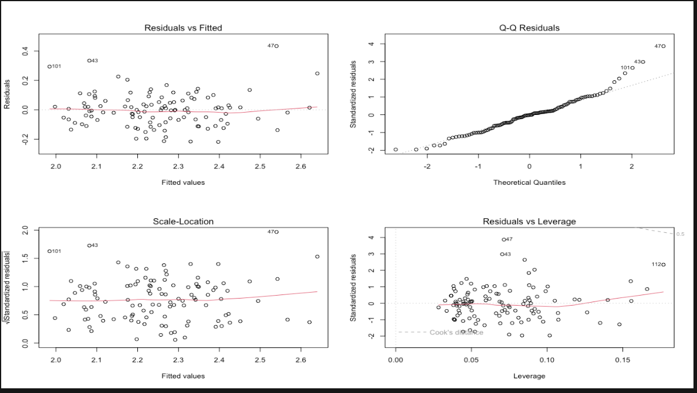
Assumptions Validation after Transformation
Residual plots
Linearity: Generally satisfied, as there's no clear non-linear pattern in the residuals vs fitted plot.
Constant Variance: Spread of residuals is more consistent across fitted values in Scale - location Plot, indicating that issue of heteroscedasticity has been reduced by log transformation.
Independence: We assume independence of observations since there is no indication from data description to suggest this is violated.
Influential outliers: No outliers outside of cook’s distance lines.
Normality: As per the Q-Q plot, residuals are approximately normally distributed, with some potential outliers in the upper tail.

Slide 17
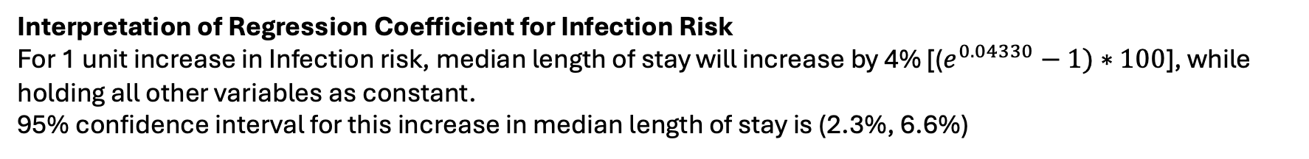
Analysis using the fitted model after transformation
log(Length_of_Stay) ~ Age + Infection_Risk + Region + Routine_Chest_Xray_Ratio+ Avg_Daily_Census
Regression coefficients
Confidence Intervals
As per this model, Infection risk is
associated with patient’s length of stay even after
accounting for other variables such as Age, Region,
Average Daily Census, etc.…
Interpretation of Regression Coefficient for Infection Risk
For 1 unit increase in Infection risk, median length of stay will increase by 4% [($e^{0.04330}−1)∗100$], while holding all other variables as constant.
95% confidence interval for this increase in median length of stay is (2.3%, 6.6%)

Slide 18
Objective 2

Slide 19
Approach
Model Building
Build another MLR model with additional complexity
Comparison of Models
Compare the additional models (MLR without complexity, MLR with Complexity and Non-Parametric model) using an error metric
Model Recommendation
Recommend the best model that can be used to predict the length of time a patient will stay at a given hospital
Build a Non-Parametric Model

Slide 20
Model 1 – MLR without Complexity
Applying log transformation of response variable since constant variance assumption is not met and building MLR model without any complexity
MLR Model 1
log(Length_of_Stay) ~ Age + Infection_Risk + Region + Routine_Chest_Xray_Ratio+ Avg_Daily_Census
Regression coefficients
RMSE (Original Scale) = 1.118647
RMSE Interpretation: Predictions are off by 12% on average relative to actual values.
MAE (Original Scale) = 0.83
MAE Interpretation: The predicted hospital stays by the model are on average 17% smaller than the actual days.

Slide 21
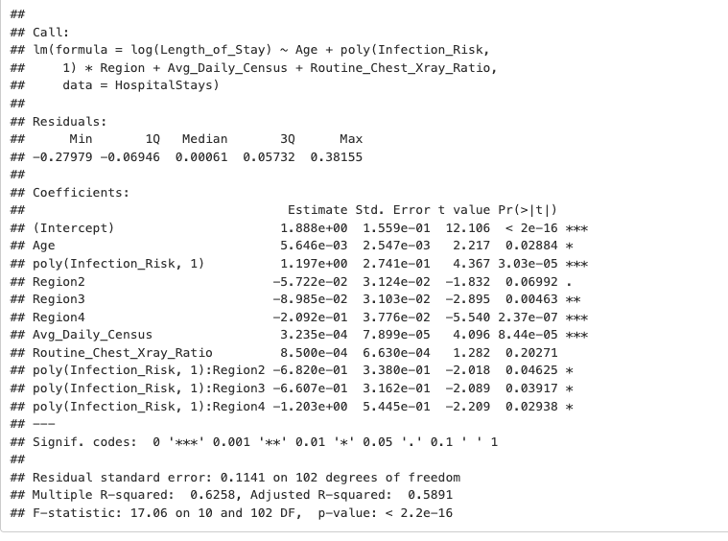
Model 2 – MLR with Complexity
Added a first-degree polynomial term for Infection_Risk & Interaction with Region
MLR Model 2
lm(log(Length_of_Stay) ~ Age + poly(Infection_Risk, 1) * Region + Avg_Daily_Census + Routine_Chest_Xray_Ratio
Regression coefficients
RMSE (Original Scale) = 1.11448
RMSE Interpretation: Predictions are off by 11% on average relative to actual values.
MAE (Original Scale) = 0.82
MAE Interpretation: The predicted hospital stays by the model are on average 18% smaller than the actual days.

Slide 22
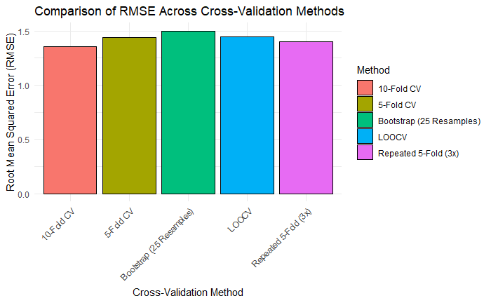
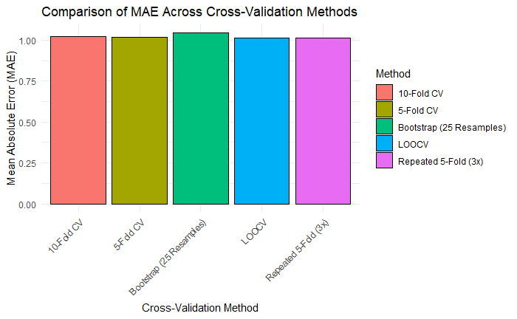
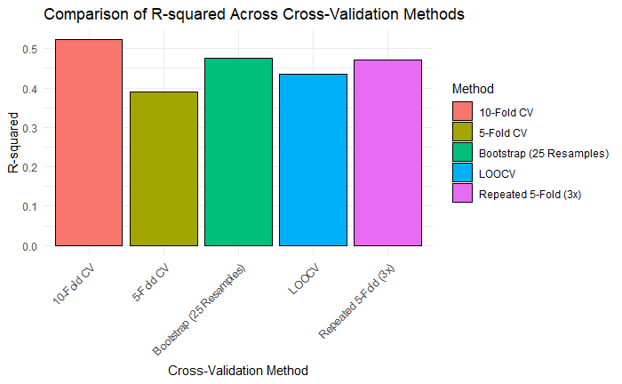
Model 3 – Non-Parametric Model: Random Forest
Validation Technique | 5-Fold Cross Validation | 10-Fold Cross Validation | Leave-One-Out Cross-Validation | Repeated 5-Fold Cross-Validation (3x) | Bootstrap 25 Resamples
RMSE | 1.439 | 1.353 | 1.445 | 1.401 | 1.499
MAE | 1.019 | 1.021 | 1.013 | 1.013 | 1.046
R² | 0.389 | 0.524 | 0.435 | 0.470 | 0.475

Slide 23
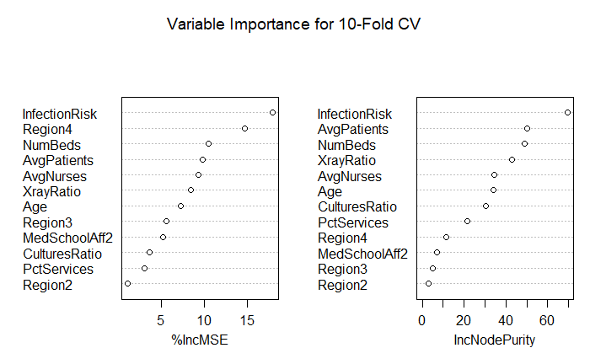
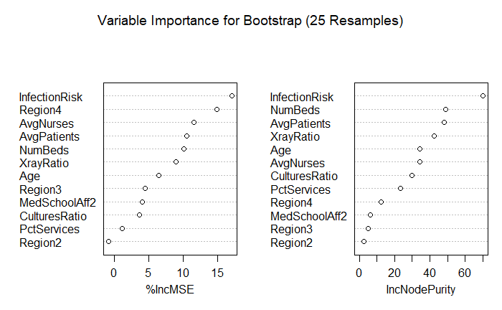
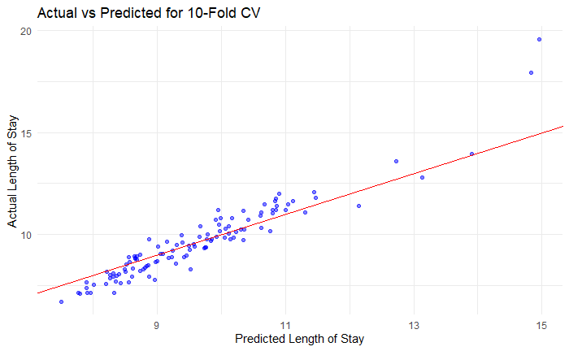
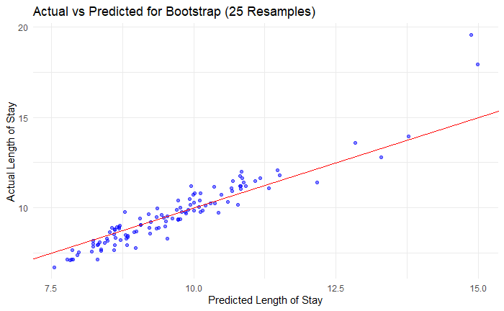
Model 3 – Non-Parametric Model: Random Forest
Variable Importance and Actual vs Predicted
Infection Risk and Region consistently chosen to have the most impact
Average Patients, Average Nurses, and Number of Beds often switch places, likely due to their collinear nature, they explain much of the same variation in the data.
Actual vs Predicted is nearly linear except from a few outliers.

Slide 24
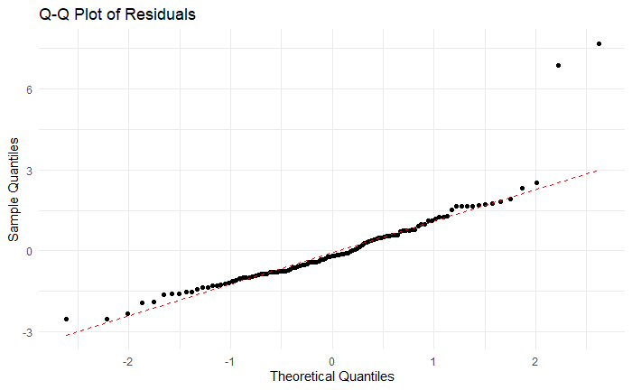
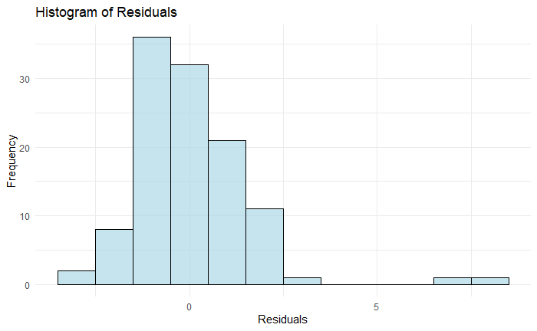
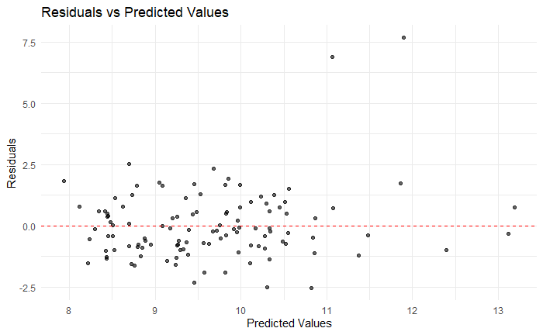
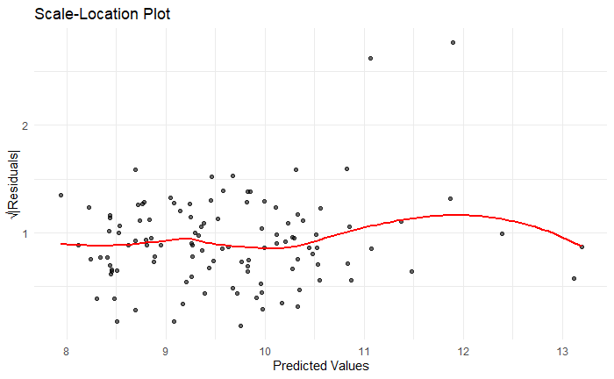
Model 3 – Non-Parametric Model: Random Forest
Normality of Residuals (Q-Q): Looking at the Q-Q plot, our residuals appear to approximate a normal distribution. There is a bit of deviation at the lower tail, though not nearly as concerning as the two very extreme values that can be seen at the upper tail.
Homoscedasticity: The spread of the residuals should not change as fitted values increase. We appear to be fairly
Model Fit Check: The Observed vs Predicted values graph visualizes how well the model’s predictions align with the actuals within our data set. Deviations from the 45-degree line suggest a poor fit and likely inaccurate predictive capabilities.
Independence: We assume independence of observations since there is no indication from data description to suggest this is violated.
Normality of Residuals (Histogram): Our residuals approximate a normal distribution fairly well, but those extreme values at the upper tail skew out distribution far to the right.
Linearity: The Residuals vs Fitted plot can also indirectly assess if there are non-linear trends in our data, which I believe is apparent in this case.

Slide 25
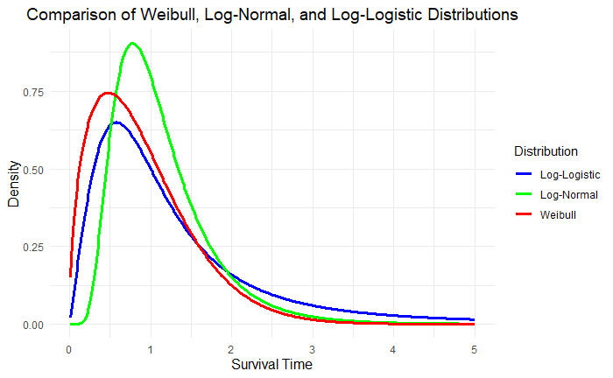
Model 4 – Parametric Survival Model: AFT Model
Model Distributions
Weibull: Assumes a Proportional Acceleration of Times
Can Model Increasing/Decreasing Hazard Rates
Not Suitable for Complex Functions that Change Directions Frequently
Not Suitable for Heavy-Tailed/Skewed Data
Log-Normal: Assumes the Log of Time is Normally Distributed
Can Inherently Model Right-Skewed Data
Not Suitable for Symmetric Distributions
Not Suitable for Left-Skewed Data
Log-Logistic: Assumes the Hazard Rate follows Logistic Distribution
Can Handle Skewed Data and is more Robust to Heavy Tails
Can Handle Data that Initially Increases and then Decreases
Not Suitable for Data with Minimal Variability
Not Suitable for Data without Heavy Tails

Slide 26
Model 4 – Parametric Survival Model: AFT Model
Final Model consists of 9 variables with 111 observations remaining after removal of outliers.
Breakdown:
6 Numerical Explanatory Variables
2 Categorical explanatory variables
2 Derived Attributes Engineered from Existing Data
1 Interaction Effect
Model Features | Description
Age | Average Age of Patients (in years)
Infection Risk | Average Estimated Probability of Hospital Infection (in Percentage, e.g. 4.1%)
XrayRatio | Ratio of # of Cultures Performed to # of Patients Without Symptoms * 100
MedSchoolAff | Medical School Affiliation (Y/N)
AvgPatients | Average Number of Patients in Hospital per Day
Region | Geographic Region (NE, NC, S, W)
ResourceToPatient | Derived Attribute: Provides Insight into Hospital Resource Availability Relative to Patient Load. (Number of Beds – Average Patients) + (Average Nurses / Average Patients)
PatientsWithoutInfectionResiduals | Derived Attribute: Helps Identify Differences in Patient Counts that are not explained by the Average Number of Patients Residuals gathered from a linear model with the Estimated Patients without Infection (Average Patients * (1 – Infection Risk)) as the Response and Average Patients as the explanatory variable.
Region*ResourceToPatient | Interaction Effect: Represents the Combined Influence of Region and Resource to Patient on the Length of Stay within a Hospital

Slide 27
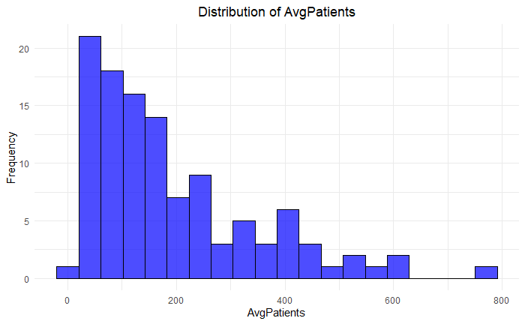
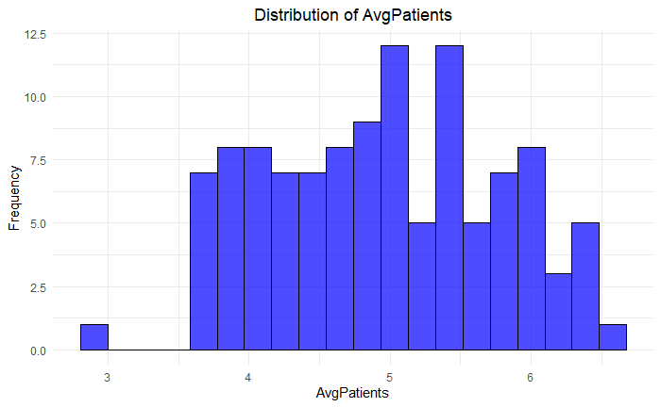
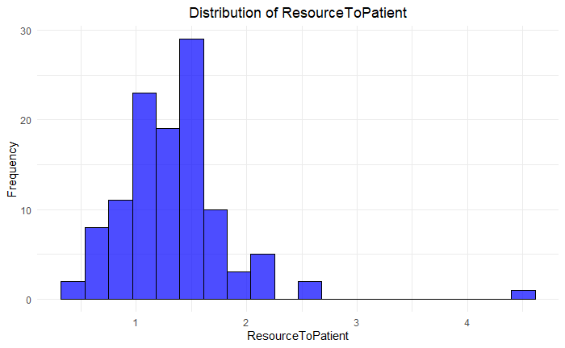
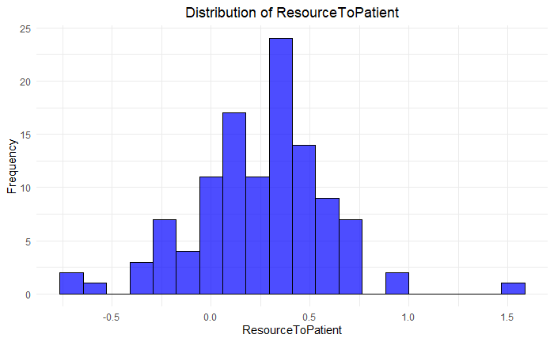
Model 4 – Parametric Survival Model: AFT Model
Model Features | Scaling Techniques (Robust Scaling)
AvgPatients | Average Patients was heavily right-skewed. Log-Transformation was applied.
ResourceToPatient | Resource to Patients was right-skewed with outliers. Log-Transformation was applied.
All Explanatory Variables | After log-transforming the previous two variables, attempting to approximate a normal distribution, we scale each feature by subtracting the median from each observation and dividing it by the inter-quartile range. This safeguards against outliers while keeping the data consistently spread to maintain variability within the central 50% of the data.

Slide 28
Model 4 – Parametric Survival Model: AFT Model
Performance Metrics
Root Mean Square Error (RMSE): Measures Predictive Accuracy
Assesses the average difference between the values the model predicts and the actual observed values.
Lower RMSE is associated with better performance as it indicates that the model is accurately predicting the data.
Akaike Information Criterion (AIC): Measures Model Fit
Delivers a balanced metric that judges a model based on the quality of fit and the complexity within it, penalizing overly complex models to give insight that helps avoid overfitting.
Lower AIC is associated with a better balance between complexity and goodness of fit.
Concordance Index: Measures Discriminative Ability
Assesses the ability of a model to correctly rank survival times of individual observations. Higher concordance is associated with better discrimination between individuals with differing survival times.
0.5 is no better than randomly guessing
1 is considered perfect predictive power
Log-Likelihood: Measures Model Fit
Assesses how well the model explains the data being observed. For survival analysis, this means the model’s likeliness for an observed survival time to come from it’s fitted distribution.
Higher Log-Likelihood values are associated with a better fit to the data.
Model Distribution | Weibull | Log-Normal | Log-Logistic
RMSE | 1.194 | 1.034 | 1.039
AIC | 363.708 | 334.953 | 329.001
Concordance | 0.791 | 0.807 | 0.806
Log-Likelihood | -166.854 | -152.476 | -149.501

Slide 29
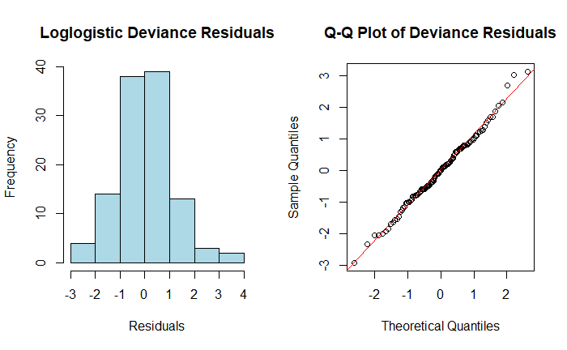
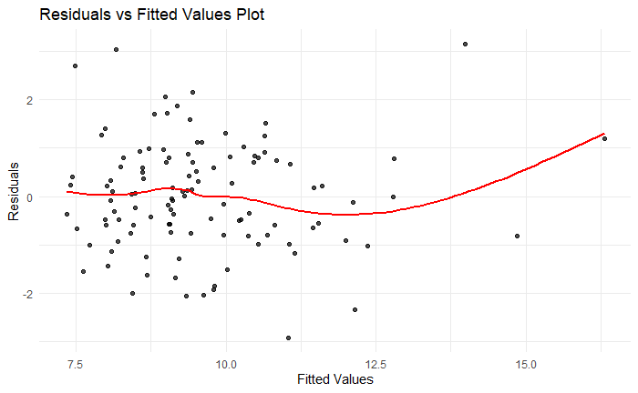
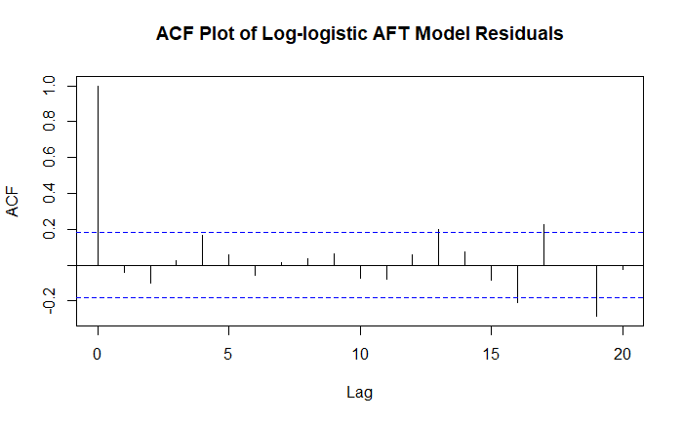
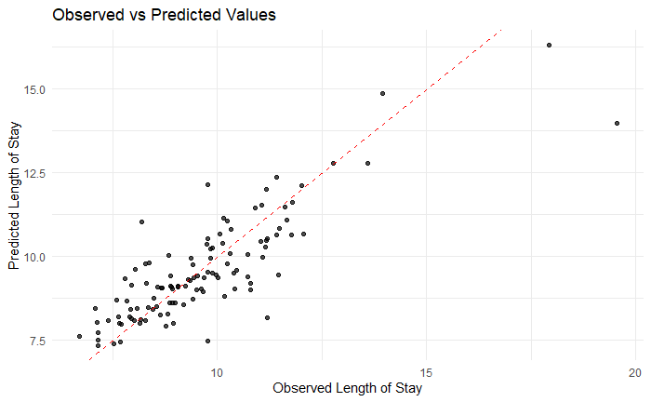
Model 4 – Parametric Survival Model: AFT Model
Normality of Residuals: Looking at the Q-Q plot, our residuals appear to approximate a normal distribution. There is some deviation at the tails, but nothing egregious that warrants re-assessment.
Homoscedasticity: The spread of the residuals should not change as fitted values increase. There’s a clear violation of this assumption, likely indicating that the model is either incorrectly capturing some features in the data or it’s missing additional attributes that could explain the behavior.
Independence of Residuals: The Autocorrelation Function Plot checks for correlation in the residuals. They should ideally be independent at each point in time, spikes in this graph that cross the blue threshold indicate that some time-related information is not being captured by the model.
Independence: We assume independence of observations since there is no indication from data description to suggest this is violated.
Linearity: The Residuals vs Fitted plot can also indirectly assess if there are non-linear trends in our data, which I believe is apparent in this case.
Model Fit Check: The Observed vs Predicted values graph visualizes how well the model’s predictions align with the actuals within our data set. Deviations from the 45-degree line suggest a poor fit and likely inaccurate predictive capabilities.

Slide 30
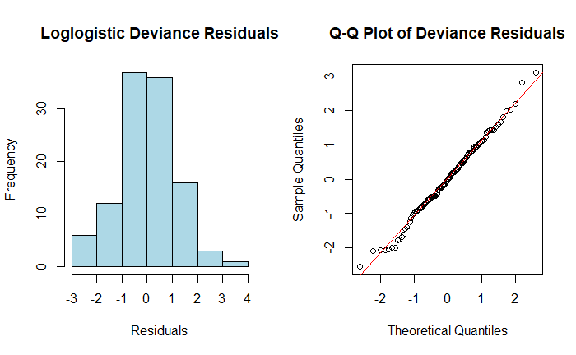
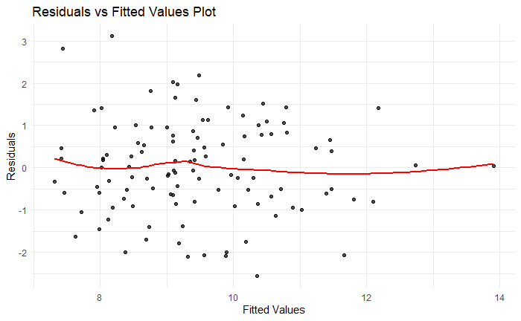
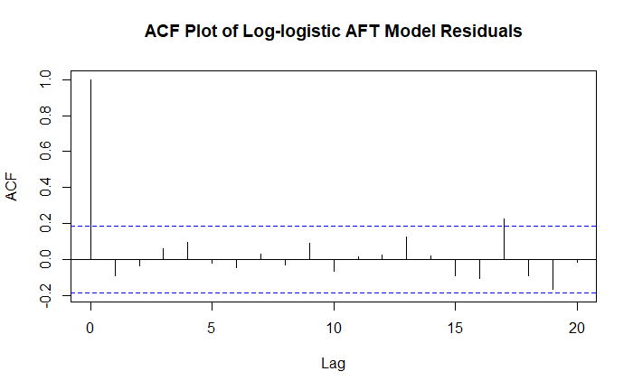
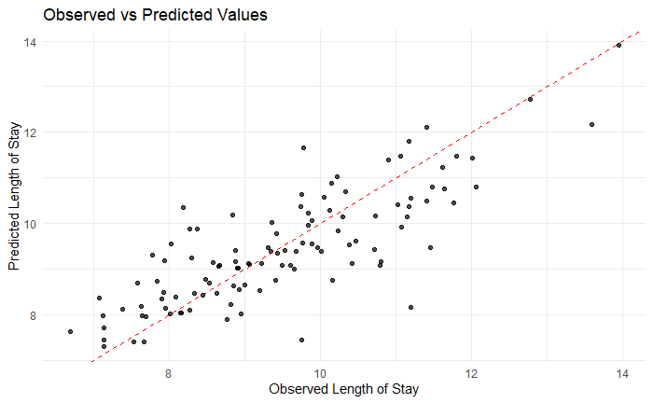
Model 4 – Parametric Survival Model: AFT Model
Normality of Residuals: After removing the two most impactful outliers in our data, the Q-Q plot fits better at the upper tail, but the lower tail has greater deviation.
Homoscedasticity: The spread of our residuals is drastically improved with outliers removed. There are still minor violations, but nothing that causes immediate concern.
Independence of Residuals: There are fewer spikes in this graph that cross the blue threshold, only one example stands out as problematic. Indicating that our outliers likely hold some deeper insight into the time-related variance that our model is not accounting for.
Independence: We assume independence of observations since there is no indication from data description to suggest this is violated.
Linearity: There still appear to be non-linear trends in our data that are being missed by the model, but the severity is significantly less.
Model Fit Check: The deviation from the 45-degree line is remarkably improved, indicating that our model likely has much greater predictive capabilities than previously.

Slide 31
Model 4 – Parametric Survival Model: AFT Model
Validation Technique
Nested Cross-Validation with 500 Bootstrap Resamples
An outer loops splits our data into training and testing sets to evaluate our final model
An inner loop then further splits the training data for hyper-parameter tuning
For this model, the parameters being tuned were the distribution selection between Weibull, Log-Normal, and Log-Logistic
Nested Bootstrap CV-Models | Weibull (#355) | Log-Normal (#111) | Log-Logistic (#236)
RMSE | 1.180 | 0.736 | 0.763
AIC | 195.645 | 326.388 | 329.520
Concordance | 0.745 | 0.824 | 0.848
Log-Likelihood | -82.822 | -148.194 | -149.760

Slide 32
Comparison of Models & Recommendation
Multiple Linear Regression Models
RMSE
MAE
R²
Adjusted-R²
Random Forest CV-Models | 5-Fold Cross Validation | 10-Fold Cross Validation | Leave-One-Out Cross-Validation | Repeated 5-Fold Cross-Validation (3x) | Bootstrap 25 Resamples
RMSE | 1.439 | 1.353 | 1.445 | 1.401 | 1.499
MAE | 1.019 | 1.021 | 1.013 | 1.013 | 1.046
R² | 0.389 | 0.524 | 0.435 | 0.470 | 0.475
Nested Bootstrap CV-Models | Weibull (#355) | Log-Normal (#111) | Log-Logistic (#236)
RMSE | 1.180 | 0.736 | 0.763
AIC | 195.645 | 326.388 | 329.520
Concordance | 0.745 | 0.824 | 0.848
Log-Likelihood | -82.822 | -148.194 | -149.760

